Slide 1

LinkingLives
Locate. Link. Lasting Change.

Slide 2
About Us
Voce Solutions, LLC, a subsidiary of Voce, (formerly known as Family Design Resources) is a mission-driven technology company, with over 20 years of experience in permanency and adoption work.
LinkingLives is a SaaS product that will provide child welfare agencies and private providers, nationwide, a digital platform that will continuously search for relatives and kin relationships.

Slide 3


Proud Partners
Funding for LinkingLives has been established by the Wolfe Family Foundation, which is managed by Jason Wolfe. Jason is the CEO and founder of Wolfe LLC and GiftYa.
Andrew Stewart
Product development for LinkingLives was led by Andrew Stewart, the founder of Weblight Development Inc. Andrew is also the co-founder of StreemPay.
Jason Wolfe

Slide 4

Mission
To identify forever homes to the over 400,000 children nationwide who are in foster care.

Slide 5

The Problem
Why do children enter the foster care system?
Children enter the foster care system when it is determined that their caretaker(s) cannot care for them and/or keep them safe. Often children enter the foster care system due to neglect, abuse and/or abandonment.
Each year in the U.S. over 23,000 children age out of the foster care system without a permanent connection leading to devastating outcomes. These young adults risk homelessness, unplanned pregnancies, addiction, incarceration and victimization by traffickers.
Federal laws mandate agencies to conduct family finding to identify and locate family members and kin to the 5th degree of blood or marriage within 30 days of removing a child from his or her home. This labor-intensive process places additional burden on already taxed caseworkers with high caseloads and insufficient time.
Agencies currently utilize tedious search methods to locate these essential supports through file mining, scouring multiple internet sites and conducting phone interviews.

Slide 6

The Possibilities
Imagine the possibility of creating networks of support for the most vulnerable population in seconds, we have -LinkingLives the 21st century advancement that child welfare has been waiting for.
LinkingLives is a digital family finding technology that will expeditiously find family and kin for the thousands of children waiting for permanency and give caseworkers tools to enhance family engagement efforts.
Agencies will have immediate access to familial and kinship connections for each child in the system. The verified connections will have a link score rating based on criminal history, proximity to the child, size of the household and much more. This score gives users a snapshot of information to assist in the placement vetting process. Users will then be able to make contact with the connections swiftly through email or text.
But is it secure? Yes! Voce Solutions, LLC, has ensured that the data is housed on a secure server and exceeds all the mandatory confidentiality and privacy requirements to operate our solution.

Slide 7
Our Solution
Voce Solutions believes every child needs a family. Our software is a fast, efficient family finding technology that will ensure every child is connected to a safe, caring adult the moment they enter the foster care system.
LinkingLives simplifies the family finding process by aggregating real-time data into user-friendly digital profiles, helping child welfare professionals to make data-informed decisions related to permanency.
With LinkingLives tracking accountability and measuring outcomes related to family finding has never been easier. This solution offers customizable reporting tools to fit each clients needs.

Slide 8



Why Us?
Voce Solutions’ LinkingLives offers the most efficient, user-friendly and only continuous search platform for family finding in the United States.
Voce Solutions staff are subject matter experts in adoption, permanency and family finding.
Voce Solutions’ LinkingLives product offers secure data with real-time solutions to achieve better permanency outcomes for children entering the child welfare system.

Slide 9

Business Model
We’re a mission-driven technology company, with over 20 years of experience in permanency and adoption work.
We offer a SaaS product, LinkingLives to the Adoption and Child Welfare Services Industry. This product revolutionizes the family finding process.
LinkingLives is a subscription-based product that provides customers the flexibility to purchase family finding services based on their need.

Slide 10


Proprietary Technology
LinkingLives, a product of Voce Solutions, is the only family finding SaaS solution on the market that incorporates interactive communication features designed specifically to meet the needs of child welfare professionals in their family finding efforts.
LinkingLives was built for and by the expertise of child welfare professionals guided by technology experts.

Slide 11

Market Size
Our Market Size measured by revenue, of the Adoption & Child Welfare Services Industry is 15.5bn.

Slide 12




Competition
Kevin Campbell’s Family Finding: a fee-for-service training model that utilizes data mining and interviews to identify connections for foster youth.
Accurint: a subscription-based people finder software, a product of LexisNexis. This application provides point-in-time reports of possible relatives and associates for the identified search subject.
Connect Our Kids: a free web-based application that provides basic family tree, possible connections and engagement templates.

Slide 13

Go-to Market Plan Customer Acquisition Channels
Demo: We will demonstrate LinkingLives to high level child welfare and human service decision makers to attract attention and gain brand ambassadors.
Free Trial: We will offer a limited free trial of LinkingLives to child welfare and human service agencies to encourage usage and promote sales.

Slide 14
Pricing Model
Standard Plus Premium*
Features: Features: Features:
Up to 100 child records Up to 300 child records Up to 500 child records
Continuous searching Export family trees Export family trees
Addresses, phone numbers, emails Email connections Email connections
Access to criminal history Continuous searching Continuous searching Intra-software messaging with users Addresses, phone numbers, emails Addresses, phone numbers, emails
Send SMS texts to connections Intra-software messaging with users Intra-software messaging with users
Link alerts Send SMS texts to connections Send SMS texts to connections
IT support Access to criminal history Access to criminal history Export reports Link alerts Link alerts
Printable contact letters IT support IT support Export reports Export reports Printable contact letter Printable contact letters
*Additional pricing available for 500+ child records

Slide 15

Fundraising & Milestones
We seek to raise an additional $100K through investors and grants in year one
We are partnering with DAZA Development, a fund development consultant to assist in these efforts
All funds raised will be injected into LinkingLives to bring our MVP to market by Fall of 2022

Slide 16

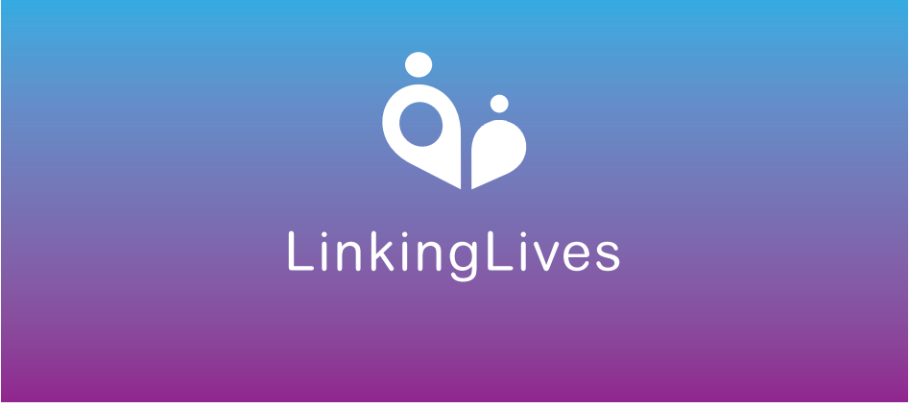
Our Product

Slide 17
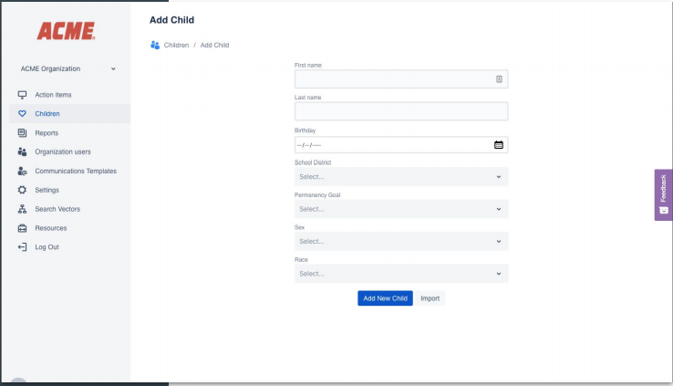
Create a Child Record

Slide 18
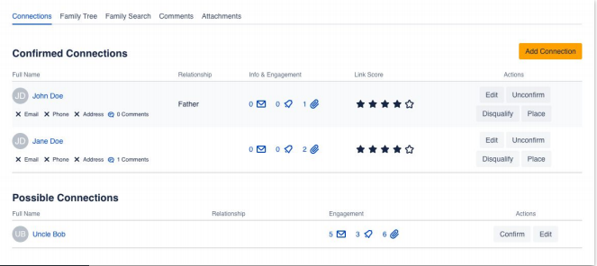
Add Connections

Slide 19
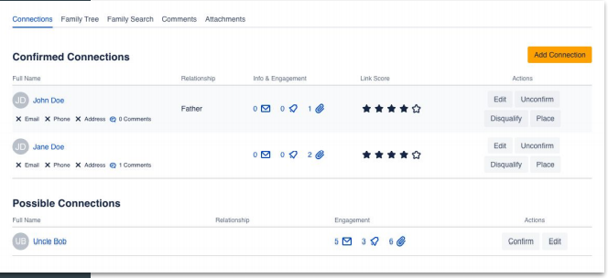
Automatically Find Contact and Connection Data

Slide 20
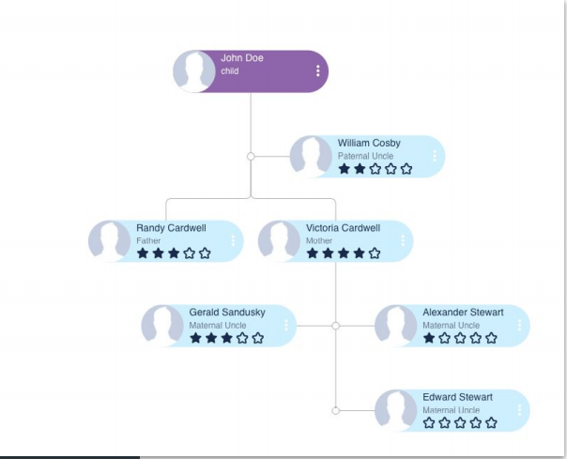
View and Update the Family Tree

Slide 21
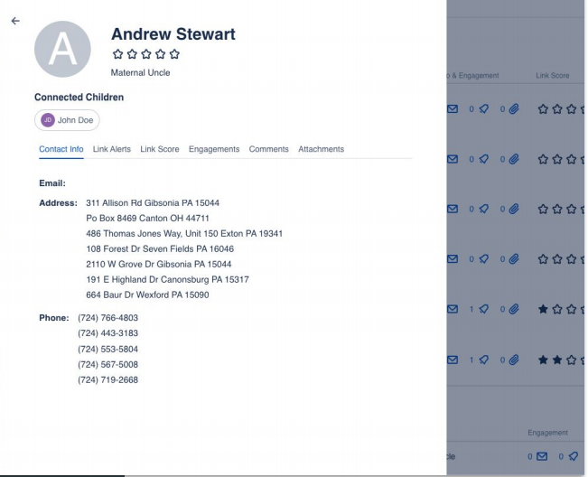
Access Connection Details

Slide 22
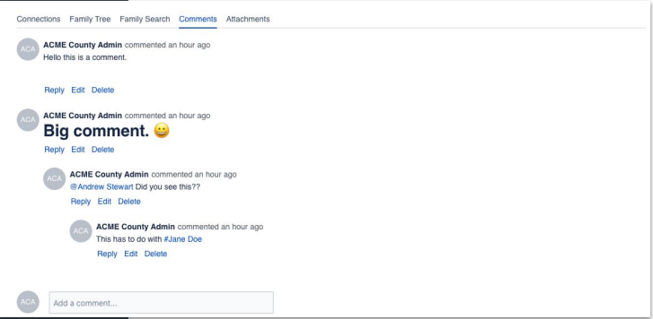
Add Comments

Slide 23
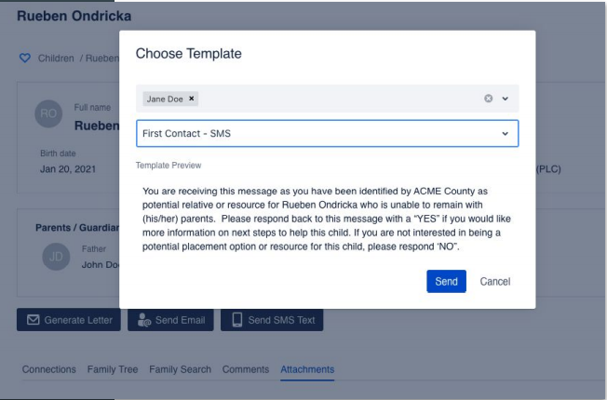
Send Engagement Communication

Slide 24
Contact Us
Learn more about LinkingLives at www.voce-solutions.com.
For pricing or to request a demo email: contactus@vocesolutions.org.
LinkingLives
Locate. Link. Lasting Change.

